Slide 1
Aeroprobe Data Reduction used by GRC Wind Tunnel Characterization Team
Aaron Johnson
David Rinehart
6/25/2019

Slide 2
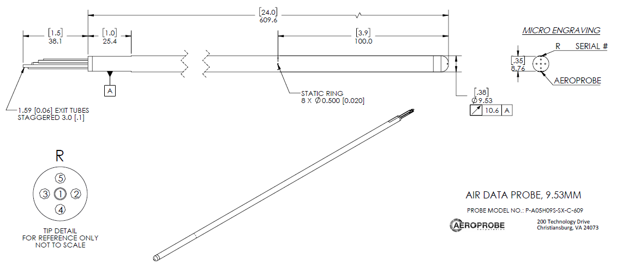
Overview
20 Aeroprobes calibrated at Mach 0.05, 0.10, 0.15, 0.20, 0.25 for the 9x15 LSWT’s Traversing Calibration Rake
490 unique angles tested using in a pitch-roll method at each speed
95 validation conditions performed at each speed, as well

Slide 3
Data File Format Example
FileType=PCF
NHL=14
Date=08/25/17 | 9:06:24
Facility=APL
Serial=16328-4
Customer=NASA
NP=6
Mach=0.050000
Calibration=1:1
CalPts=490
TstPts=95
PortNumbering=AP Standard
Units=Torr C m/s kg/m^3 deg mm
Theta[deg] | Phi[deg] | P1[Torr] | P2[Torr] | P3[Torr] | P4[Torr] | P5[Torr] | P6[Torr] | Pt[Torr] | Ps[Abs,Torr] | Ts[C]
0 | 0 | 1.27885 | 0.71698 | 0.71617 | 0.71604 | 0.72338 | 0.0078 | 1.26997 | 708.018 | 24.5
1.691 | 128.401 | 1.28438 | 0.68364 | 0.74261 | 0.74609 | 0.68757 | 0.00745 | 1.27561 | 708.116 | 24.5
P1 – total
P2-P5 – flow angle ports
P6 – static
Pt – free jet total pressure
Ps – free jet static pressure (absolute)
Pressure referenced to Ps;
need to add Ps back into measured differentials

Slide 4
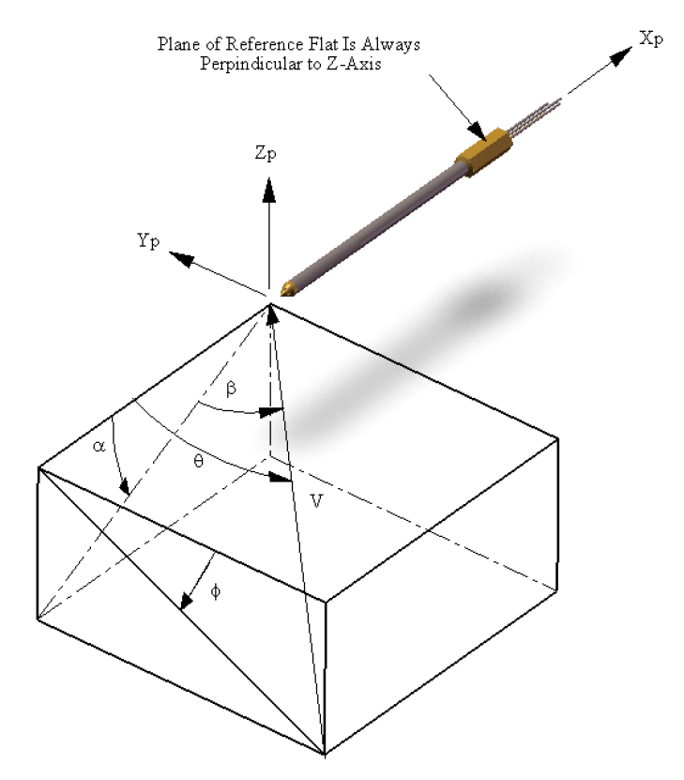
Angle Calculations into Typical Pitch/Yaw
Theta & Phi supplied by Aeroprobe
My steps:
Calculate M & V of free jet
u = V*cos(theta)
v = V*sin(theta)*cos(phi)
w = V*sin(theta)*sin(phi)
Pitch = atan(w/u)
Yaw = -atan(v/u)

Slide 5
Probe Calculations
Inputs to Regression Model, X’s:
CA = (P4-P5)/(P1-Pavg) where Pavg = mean(P2,P3,P4,P5)
CB = (P3-P2)/(P1-Pavg)
CM = P6/P1
CM has been defined differently by other people, i.e. CM = (P1-Pavg)/P1
Outputs of Regression Model, Y’s:
Pitch & Yaw (from previous slide)
Co = (P1-PT)/(P1-P6) where PT is free jet total pressure
Co is total pressure correction factor
Cq = (P1-P6)/(PT-PS) where PS is free jet/“true” static pressure
Cq is dynamic pressure correction factor

Slide 6
Regression Models
3-factor step-wise cubic polynomial
Stepwiselm() function used in MATLAB using ‘poly333’
Includes interaction terms
Pitch = f(CA,CB,CM)
Yaw = f(CA,CB,CM)
Co = f(CA,CB,CM)
Cq = f(CA,CB,CM)

Slide 7
Comments
To reduce the variance of the model, a narrower band of flow angles is typically chosen; 20 degrees is excessive for wind tunnel characterization testing
Flow angles typically less than 2 degrees in 8x6, 9x15, and 10x10, and less than 5 degrees in IRT.
Aeroprobe indicated that their free jet doesn’t allow the entire probe to stay in the free jet past 7 degrees of flow angle, therefore, we exclude all angles (sqrt(Pitch^2+Yaw^2)) greater than 7.0

Slide 8
Example of Resulting Coefficient Table
 | Flow Angularity Probe - Pitch Flow Angle Coefficients
 | Probe Serial Number
TERMS | 16328-1 | 16328-2 | 16328-3 | 16328-4 | 16328-5 | 16328-6 | 16328-7
(Intercept) | 6.23676206E+01 | 2.70471609E+04 | 1.54757875E+01 | 4.71986750E+03 | 7.58073306E+03 | 4.71758553E+03 | -2.64344840E+03
CA | 2.95341687E+00 | -4.81452163E+02 | -3.62634221E+02 | 8.65257872E+01 | -3.31861566E+02 | -4.12536800E+02 | 7.01688139E+01
CB | -9.66822268E+01 | 1.46637780E+00 | -1.16108497E-01 | 1.35357459E+00 | 8.19846658E-01 | 2.49159850E+00 | -1.18294399E+02
CM | -1.29176745E+02 | -8.27298342E+04 | -3.20395493E+01 | -1.44581282E+04 | -2.32390631E+04 | -1.44470124E+04 | 8.08324020E+03
CA^2 | -4.27510473E-02 | 1.25630900E-02 | 2.82359975E-02 | 3.58222985E-02 | -3.92689805E+00 | 9.09893288E-03 | -4.17713015E-03
CA:CB | -2.35451809E-02 | -2.67658964E-02 | -5.22612211E-03 | -2.34260881E-02 | -4.81782334E-02 | -3.58151063E-02 | -5.94803018E-03
CB^2 | -9.87494445E-03 | -4.95843858E-03 | 5.14646799E-04 | 6.99291347E-04 | -2.41578642E+00 | 3.12916473E-03 | -2.26621270E-02
CA:CM | 5.33767951E+00 | 9.92830844E+02 | 7.52515904E+02 | -1.64987046E+02 | 6.87557038E+02 | 8.51966061E+02 | -1.33137318E+02
CB:CM | 1.97992524E+02 | -1.51863712E+00 | 0.00000000E+00 | -1.37469071E+00 | -8.63117609E-01 | -2.53679922E+00 | 2.43865189E+02
CM^2 | 6.71952019E+01 | 8.43352139E+04 | 1.68824949E+01 | 1.47604233E+04 | 2.37448579E+04 | 1.47442322E+04 | -8.23792439E+03
CA^3 | -3.48126313E-01 | -2.95641467E-01 | -2.23379578E-01 | -3.28770294E-01 | -2.49789552E-01 | -3.43480750E-01 | -3.21217202E-01
CA^2:CB | 0.00000000E+00 | 0.00000000E+00 | 0.00000000E+00 | 0.00000000E+00 | 0.00000000E+00 | 0.00000000E+00 | 0.00000000E+00
CA:CB^2 | -3.69467389E-01 | -3.32912253E-01 | -3.20931566E-01 | -3.07288578E-01 | -2.69096590E-01 | -3.51517142E-01 | -2.97695178E-01
CB^3 | 0.00000000E+00 | 0.00000000E+00 | 0.00000000E+00 | 0.00000000E+00 | 0.00000000E+00 | 0.00000000E+00 | 0.00000000E+00
CA^2:CM | 0.00000000E+00 | 0.00000000E+00 | 0.00000000E+00 | 0.00000000E+00 | 3.96544405E+00 | 0.00000000E+00 | 0.00000000E+00
CA:CB:CM | 0.00000000E+00 | 0.00000000E+00 | 0.00000000E+00 | 0.00000000E+00 | 0.00000000E+00 | 0.00000000E+00 | 0.00000000E+00
CB^2:CM | 0.00000000E+00 | 0.00000000E+00 | 0.00000000E+00 | 0.00000000E+00 | 2.45327386E+00 | 0.00000000E+00 | 0.00000000E+00
CA:CM^2 | 0.00000000E+00 | -5.03173193E+02 | -3.81702947E+02 | 8.67108712E+01 | -3.47509828E+02 | -4.31214153E+02 | 7.11584375E+01
CB:CM^2 | -1.01392545E+02 | 0.00000000E+00 | 0.00000000E+00 | 0.00000000E+00 | 0.00000000E+00 | 0.00000000E+00 | -1.25576699E+02
CM^3 | 0.00000000E+00 | -2.86523346E+04 | 0.00000000E+00 | -5.02189490E+03 | -8.08621347E+03 | -5.01431962E+03 | 2.79861402E+03

